Slide 1
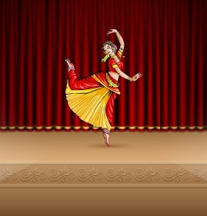
StepSyncApplication
The webcam which is the canvas element is sourced from the teachable machine model.
Teachable Machine Model Steps–
Collected datasets from Kaggle or captured datasets from our team members.
Fed datasets into each feature by categorizing them
Training the model! While the model is training the weights get adjusted
Exported the model into a google teachable machine model (Next Slide ⏭️)
The key points are used for detecting the users dance postures. The progress bar is for whether the user is doing the pose accurately or not. The first dropdown menu is for changing the posture. The second dropdown menu is for to change the language of the feedback subtitles. The auditory feedback is for the user to listen to the feedback instead of reading the feedback subtitles. The video tutorials are for the user to learn dance postures and dance steps. The social media links are for the user to share their application with other dancers.

Slide 2
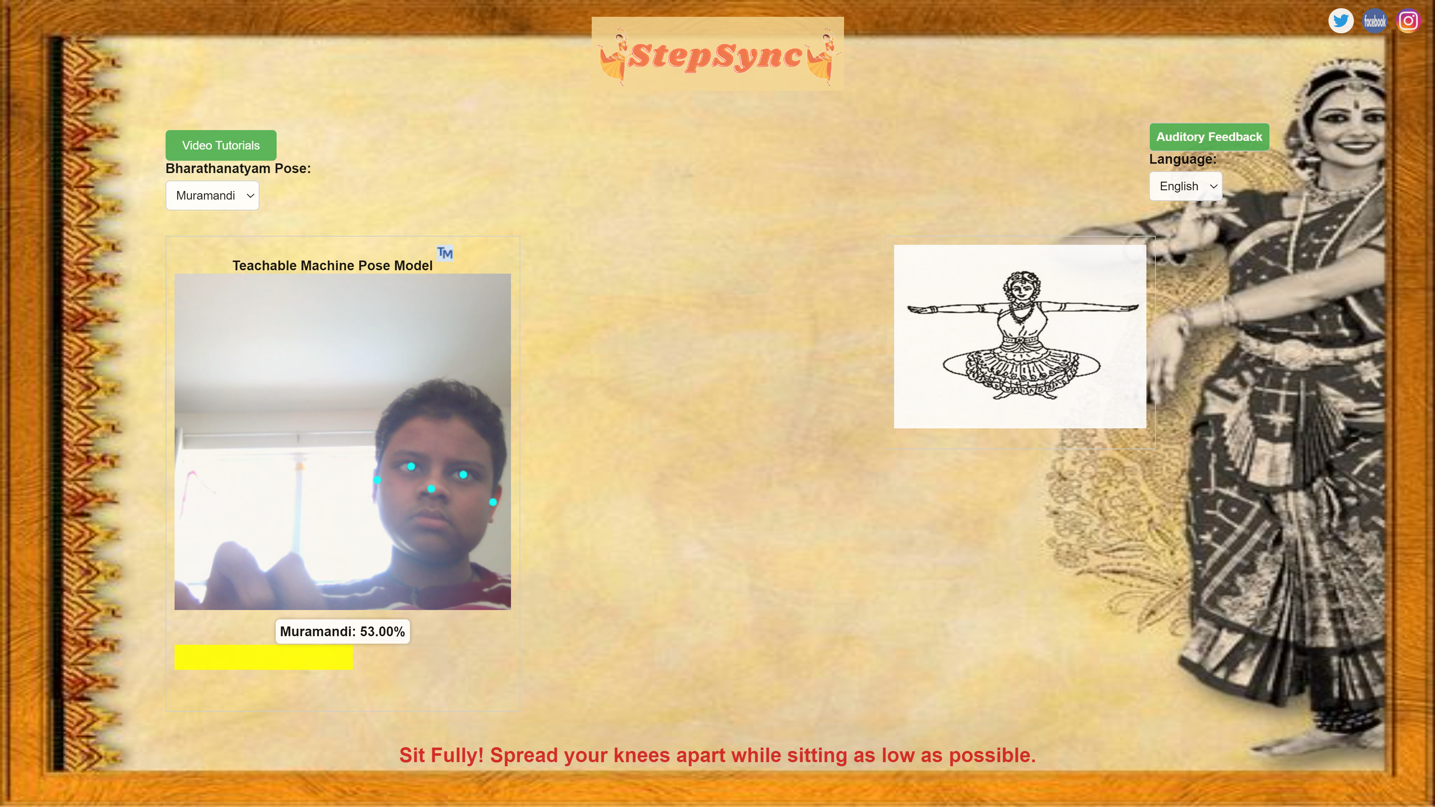
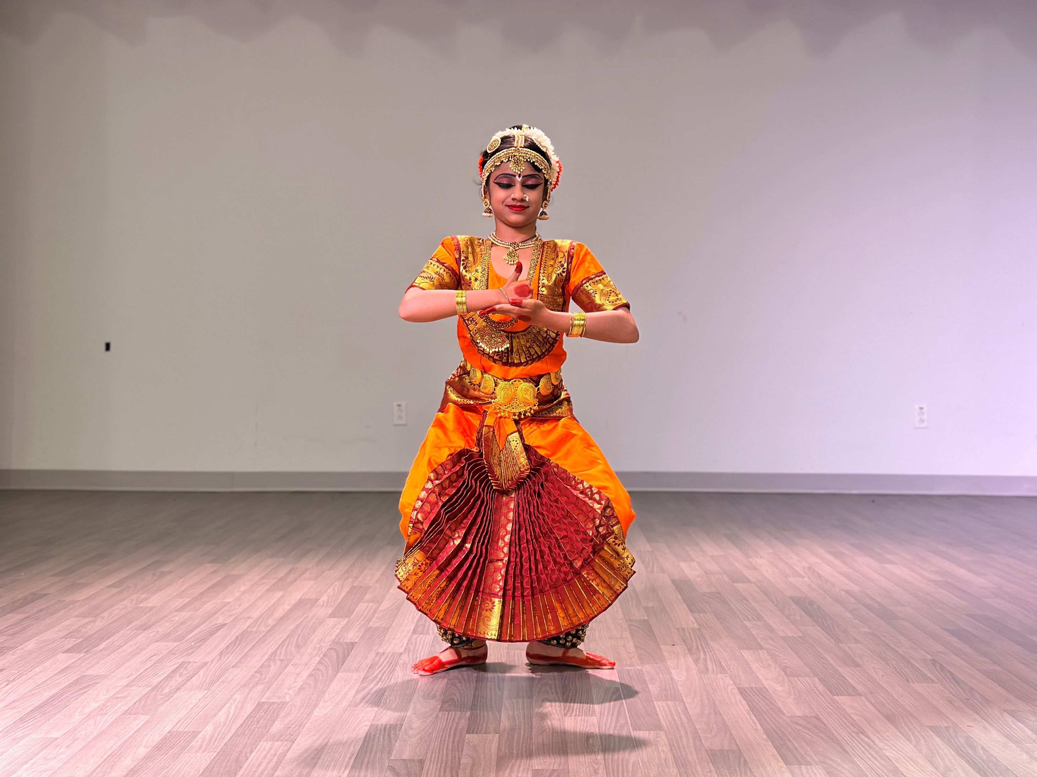
Video Tutorials Button
Auditory Feedback Button
Social Media Icons
Language Dropdown
Pose Dropdown
StepSyncLogo
TM Header
TM Logo
Webcam
TMPoseModelPanel
Picture
Pose Accuracy
53%
Feedback Text
Progressbar

Slide 3
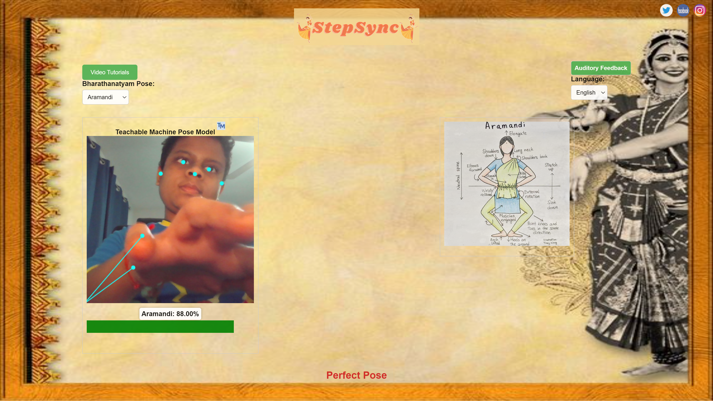
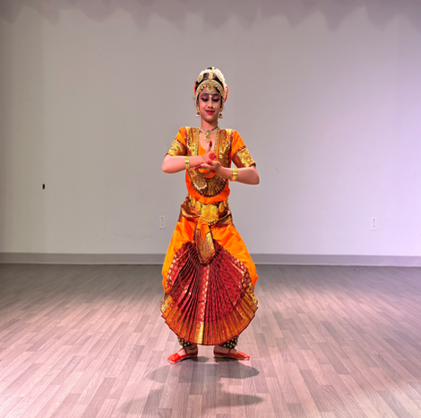
Social Media Icons
Video Tutorials Button
Auditory Feedback Button
Pose Dropdown
Language Dropdown
StepSyncLogo
Webcam
Pose Picture
Pose Accuracy
88%
Progressbar
Feedback Text

Slide 4


88%

